Slide 1

Bull Market or Bear Market: Time Series Price Prediction for Q1 2024:
Team 1:
John Vincent Deniega
Ravita Kartawinata
Gabriella Rivera
Master of Science in Applied Data Science, University of San Diego

Slide 2
Problem statement and goal
Current Issue
A prolonged downturn in economic activity
Market experiencing significant volatility in Q4 2023
Difficult to predict financial market and their subsequent investment vehicles such as SPY, AMZN
Goal
To be able to inform investors to make better investments, and we aim to use time series analysis to find ways to find those "better ways“
Find model or method that can predict prices accurately in the future
Find a model or method that can predict what influences the stock market price direction
Success criteria : +/- 20% Prediction error
Notes:
In the fourth quarter of 2023, the US stock market is experiencing significant volatility. Objective is to analyze and understand the current environment across multiple dimensions in order to predict with sound data science principles where the US stock market will be by the end of the first quarter of 2024. Success criteria includes whether three-month prediction interval of S&P 500 was within within a 90% confidence interval for at least 90% of periods and final price APE < 10%.
Background:
As expected, this search trend was captured during the start of the great recession which was influenced by the housing market crash in 2008 (Hudomiet et. al., 2011). This was then followed by the most recent COVID-19 recession which was the second steep decline in economic activity in the last 15 years.
Since then, there has been notable literary data derived from 42 recessions in 14 countries using quarterly periods that have high potential for correctly forecasting the next recession (Kroencke, 2022). It is said that stock prices dropped significantly at about 30% at the start of recession while dividends fell on average by 13%
The goal is to predict with sound data science principles where the US stock market will be by the end of the first quarter of 2024 to ultimately manage risk and build capital.
Financial markets and their subsequent investment vehicles present significant opportunity to manage risk and build capital. Through deeper understanding of the underlying characteristics of the markets and these vehicles, we may be able to leverage our growing knowledge of time series analysis to decompose price movements by price level, price trend, quarterly seasonality, and noise. Furthermore, understanding what may influence these components further aims to strengthen our ability to perform time series price prediction to manage risk and build capital.
Goal:
Fluctuations of the market often occurred on a short-term basis.

Slide 3
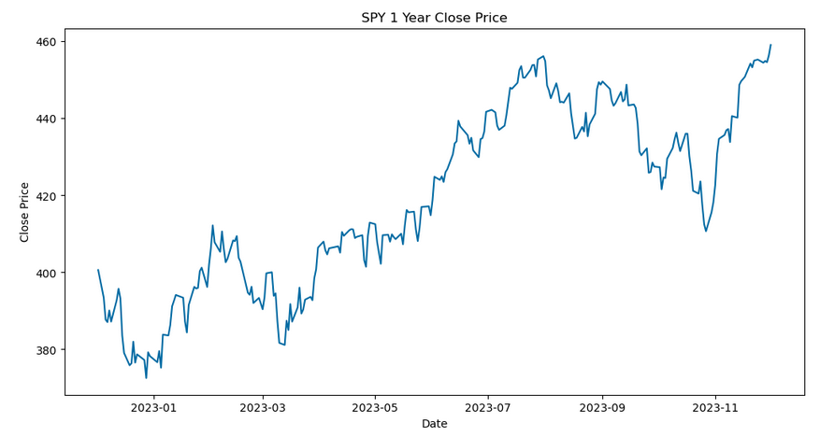
Data source and information
Data Source
Finance Yahoo Library (yfinance)
Data Information:
SPY : SPDR S&P 500 ETF is traded on the NYSE
AMZN : Amazon Inc. is traded on the NASDAQ
Time Period : 5 years (most recent year for valid.)
Notes:
Dataset is live financial market data sourced from Yahoo Finance using the Python application programming interface, yfinance to pull/scrape live data. Interface is licensed under Apache Software License as of submission.
Data source, number of variables, size of dataset, etc:
Data is sourced from Yahoo Finance with an extensive set of modules, attributes, and methods available to be utilized in Python. There are at least 14 callable methods with at least 20 attributes or original variables. Size of the dataset is not applicable due to the source consisting of live data

Slide 4
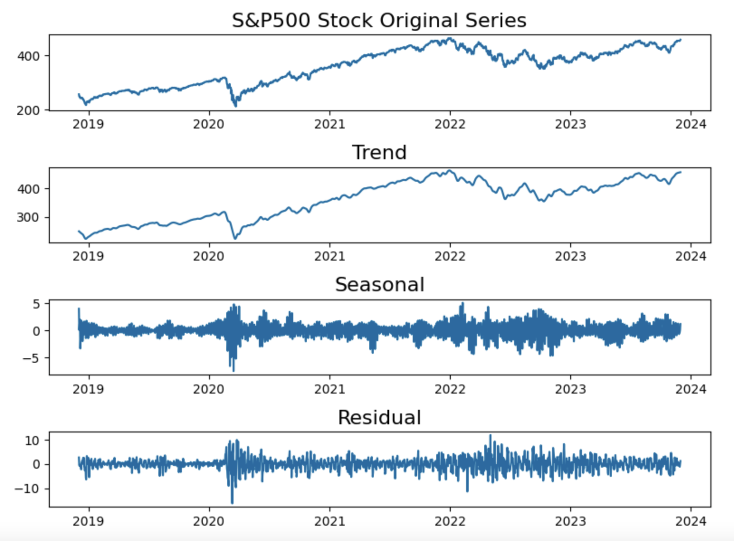
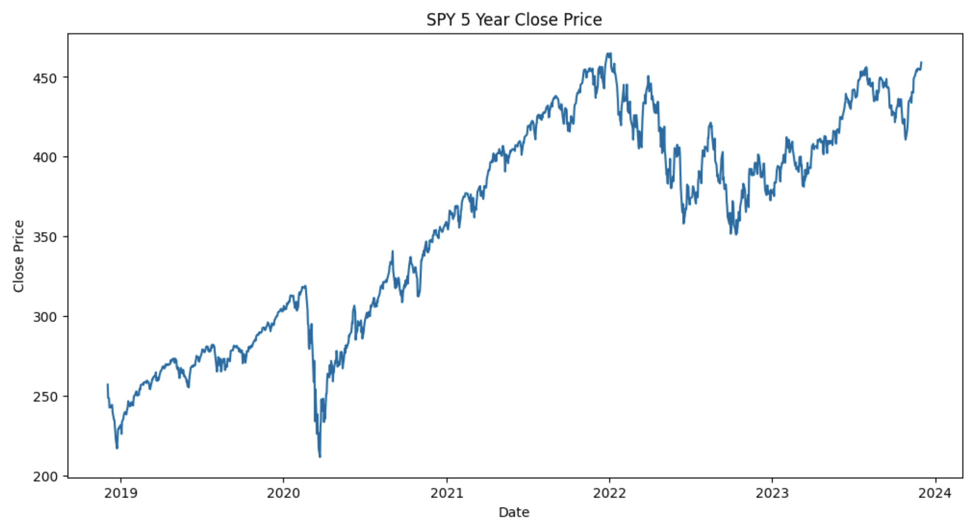

EDA: SPY500 Closing stock prices

Slide 5
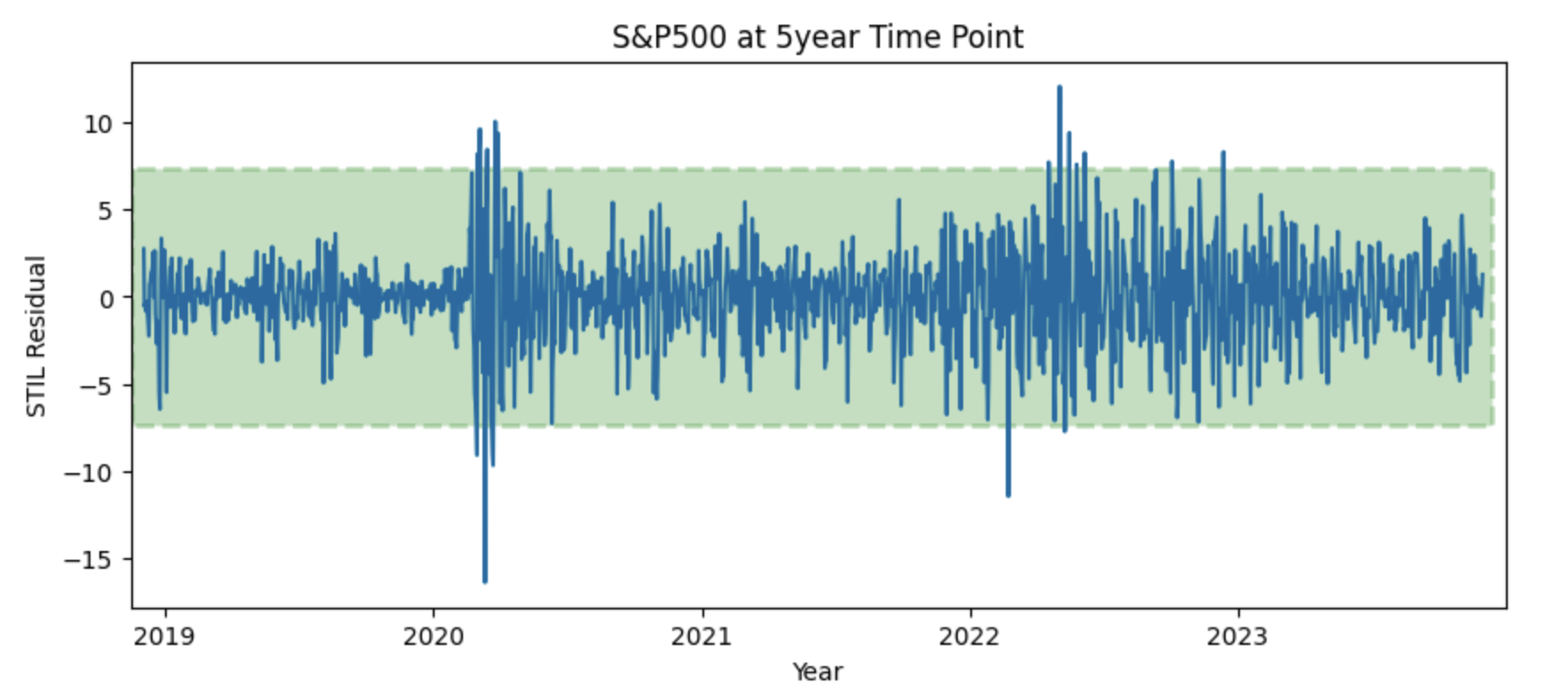
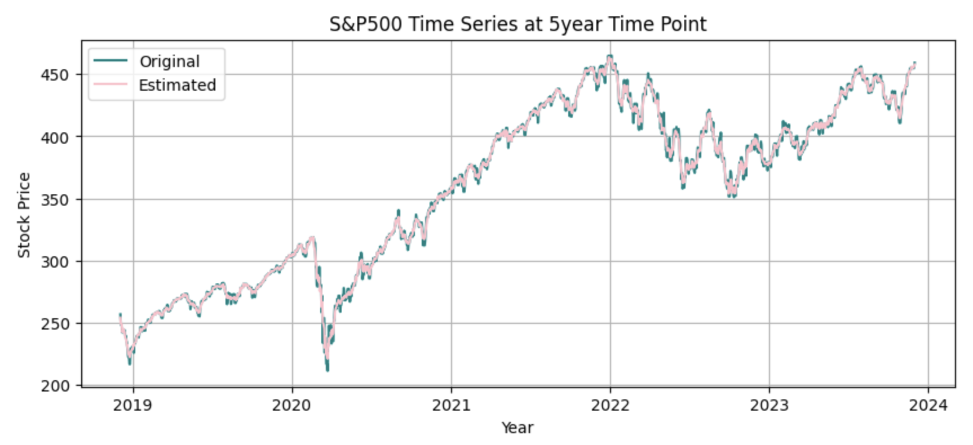
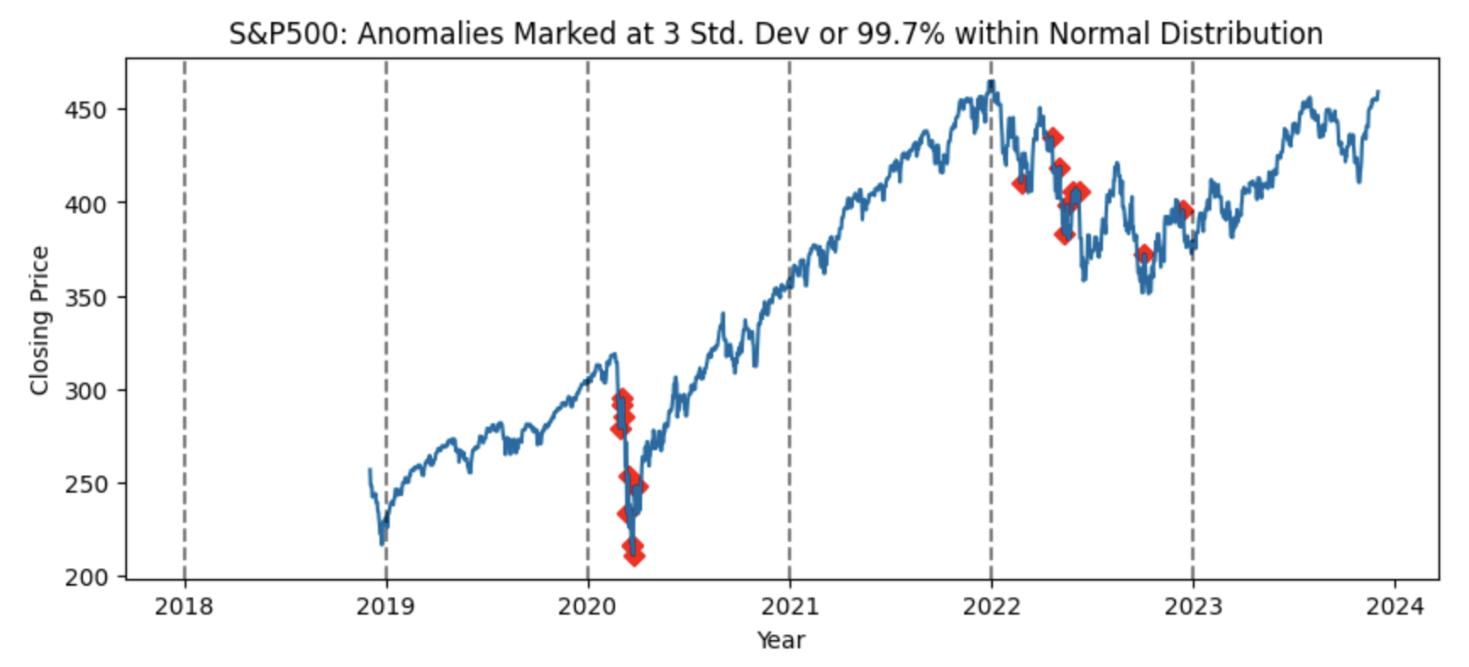
EDA: SPY500 Closing stock prices

Slide 6
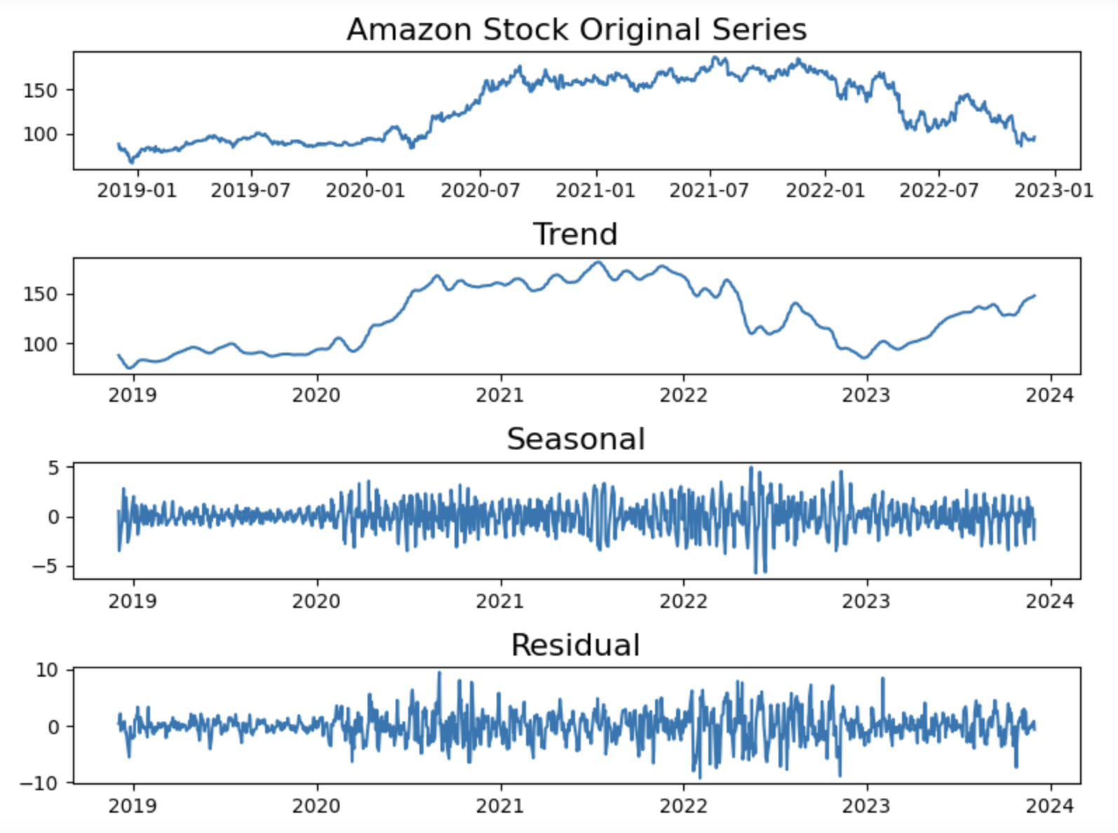
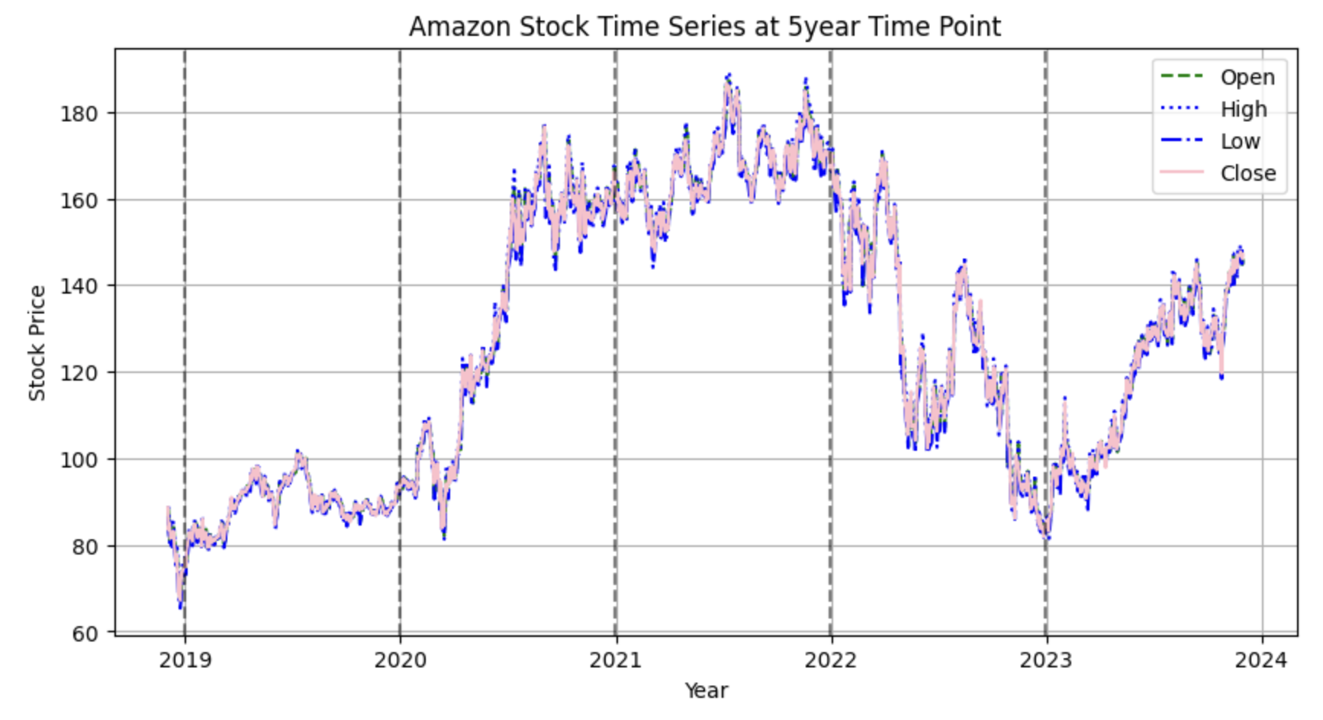
EDA: Amazon Closing stock prices

Slide 7
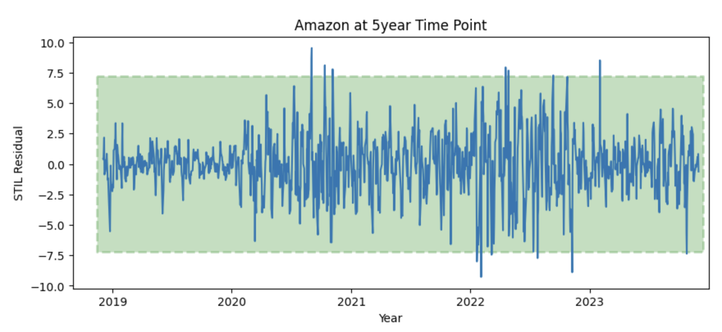
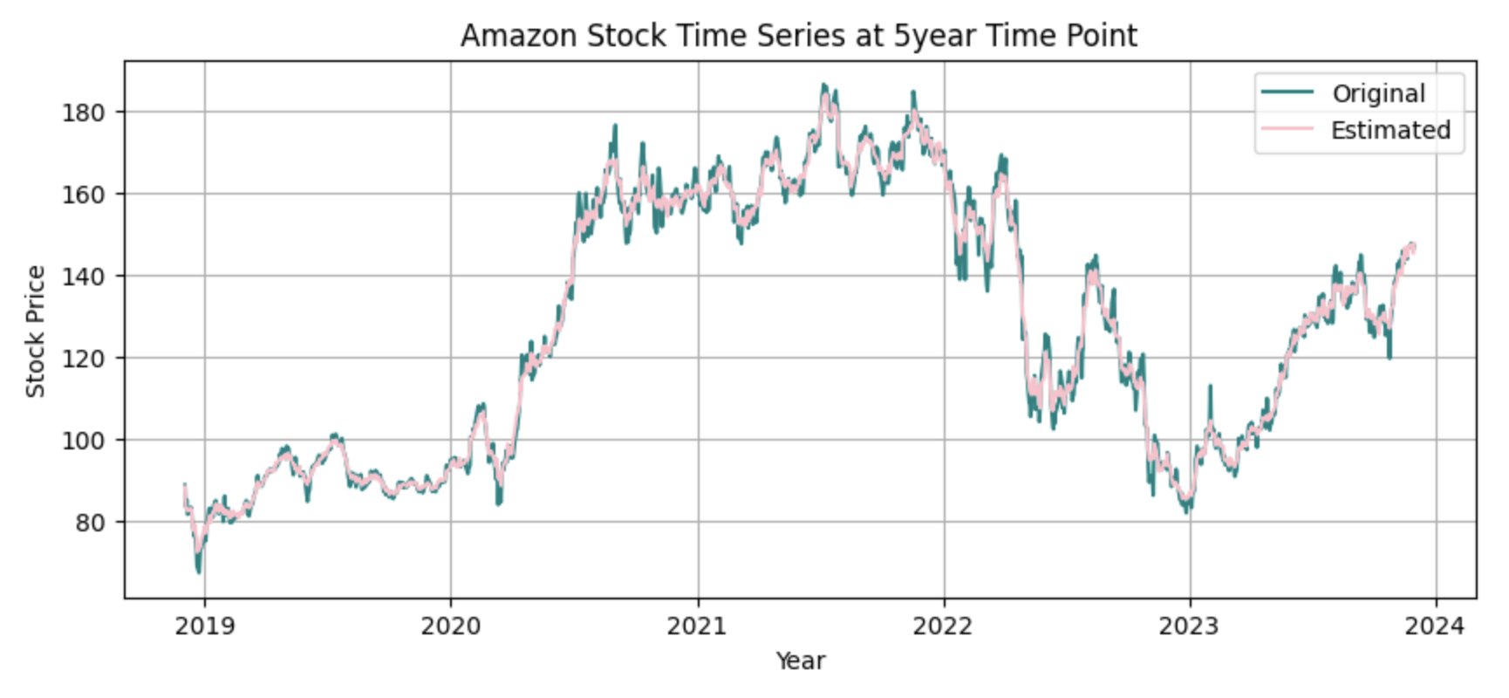
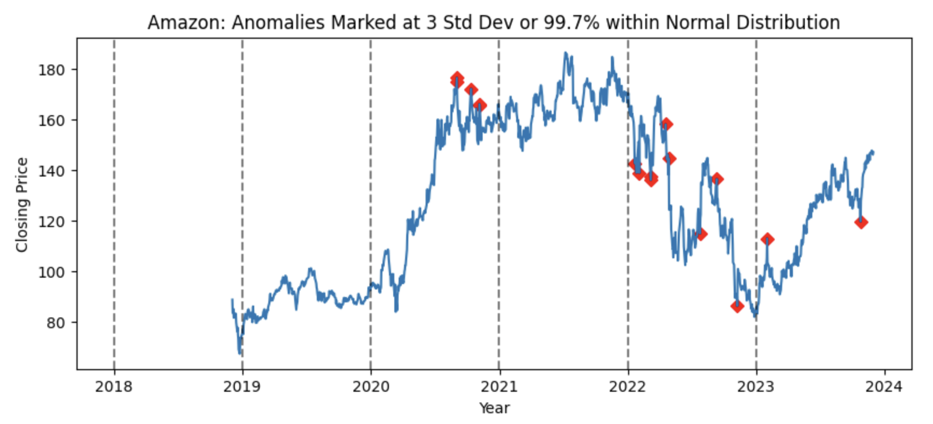
EDA: Amazon Closing stock prices

Slide 8
Domain expertise: likely cause
AMZN – +118% in 170 days (16 Mar 2020 – 2 Sep 2023)
SPY – +115% in 652 days (23 Mar 2020 – 4 Jan 2021)
AMZN increased more than broader market (SPY) in 1/4th of the time
Likely due to COVID redirecting customers to e-commerce over physical
Bi-weekly seasonality may also coincide with conventional bi-weekly pay
Sentiment on business’ future leads stock price action
Notes:
-Thanks Gabi!
-So what actionable insights can we extract from this data?
-AMZN is the third largest component of the S&P
-So, we expect some correlation and similar price movements between the two as you've seen with those anomalies.
-As investors purchase shares in the S&P, they effectively purchase AMZN as a proportion of that as well
-How may we differentiate the influences b/w two for predictive power?
-Using S&P as the control to represent the broader market, we see that AMZN
-- Increased 118% in six months starting March 2020
-- Meanwhile, the S&P increased nearly the same in nearly two years.
-- So what may have caused AMZN to reach its peak in one-fourth the time of the broader market?
- Pandemic lock downs of physical locations increased consumer dependence on e-commerce, of which AMZN dominates. As such, investors acknowledge in price.
- Bi-weekly seasonality may be attributed to conventional bi-weekly pay schedules
- And, the data suggests that how investors feel about a business's future is more reflective of the current price than how they they feel about the business at that present moment

Slide 9
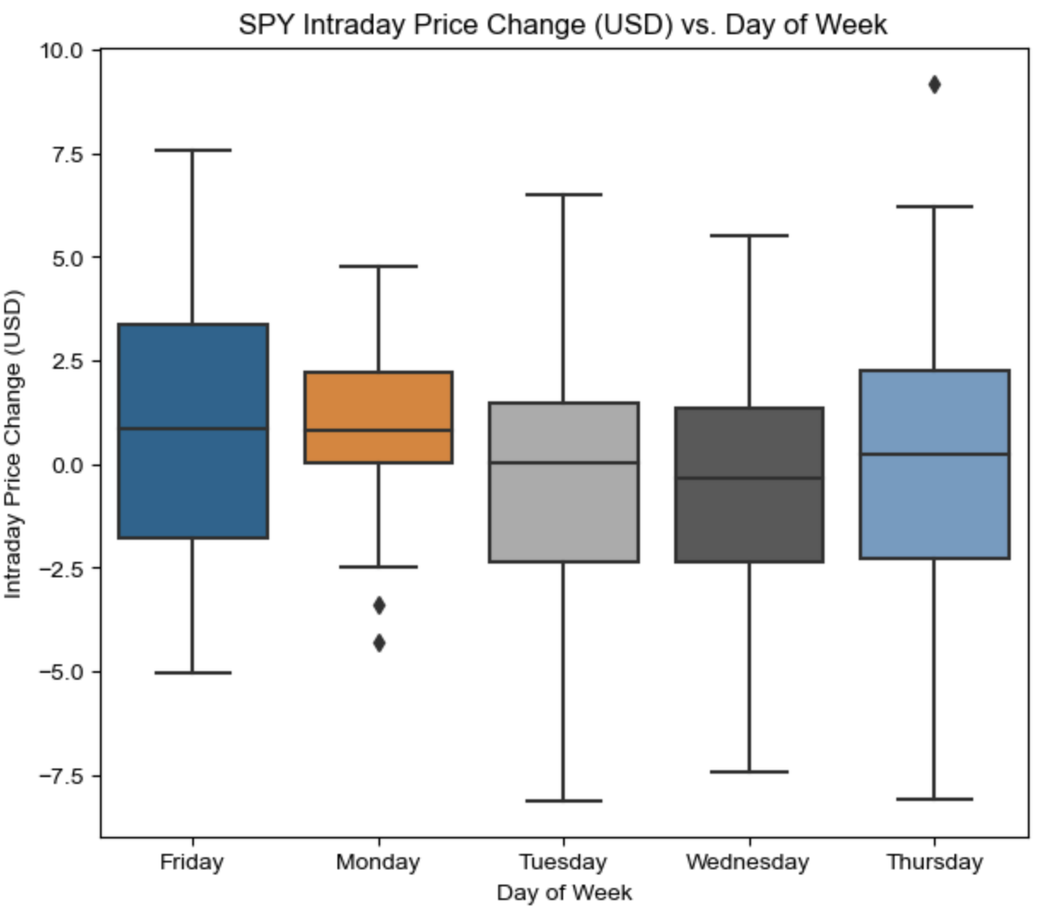
SPDR S&P 500 ETF Trust (SPY) statistic per share
 | Mon | Tues | Wed | Thu | Fri
Average | $0.96 | -$0.21 | -$0.45 | -$0.07 | $0.75
Median (50th Pct) | $0.83 | $0.03 | -$0.34 | $0.24 | $0.85
Volatility (68% likelihood fluctuation) | $2.09 | $3.04 | $2.84 | $3.72 | $3.15
Notes:
When drilling down into the weekly behavior of these investments, the S&P 500 reveals a general tendency for positive price action on Mondays with the lowest expected volatility of the week.
Thursdays, on the other hand exhibit mixed tendencies on price action, but are also the most volatile of the week.

Slide 10
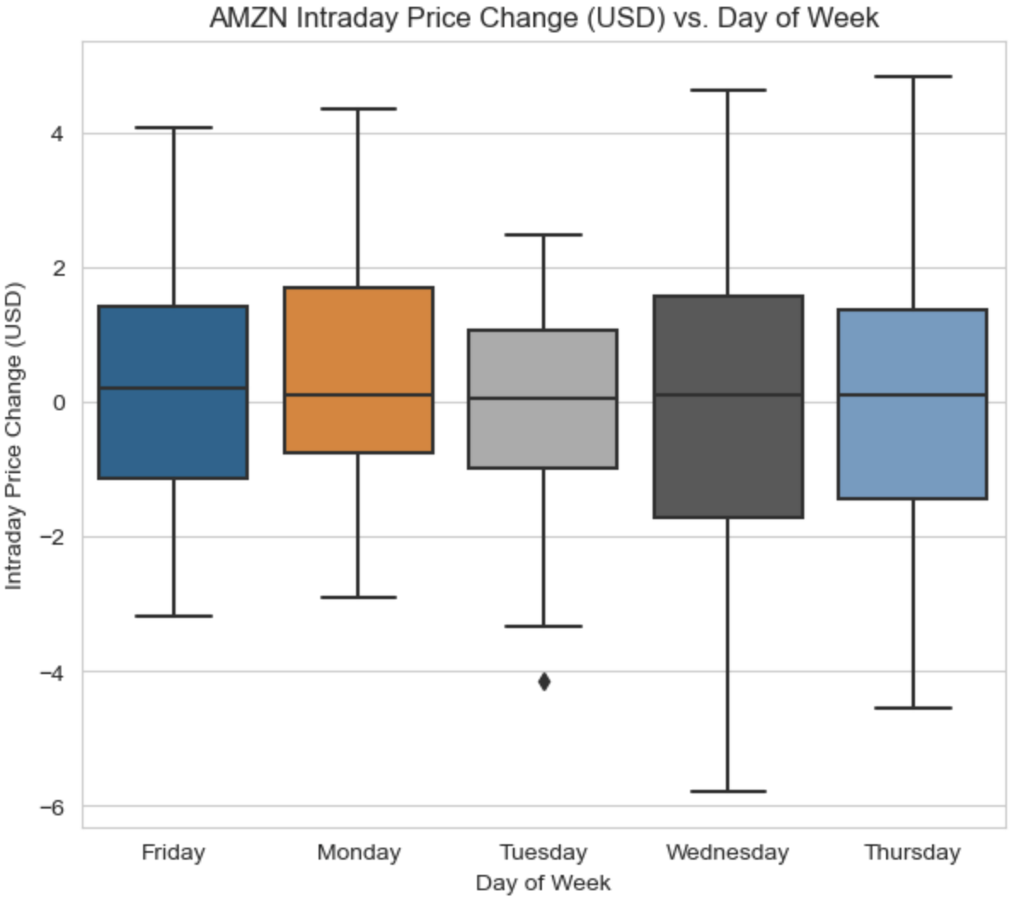
Amazon.com incorporated (amzn) statistics per share
 | Mon | Tues | Wed | Thu | Fri
Average | $0.28 | -$0.10 | -$0.05 | $0.08 | $0.32
Median (50th Pct) | $0.11 | $0.05 | $0.11 | $0.11 | $0.20
Volatility (68% likelihood fluctuation) | $1.64 | $1.58 | $2.22 | $2.07 | $1.87
Notes:
With Amazon, the data suggests that Tuesdays are the least volatile day of the week on price action, but are then followed with the most volatile price action on the very next day, Wednesdays.
Effectively, investors may treat the average and the median as indicators of likelihood of a positive or negative day, whereas volatility may be treated as the risk profile to where volatility reflects the magnitude of risk or gain.

Slide 11
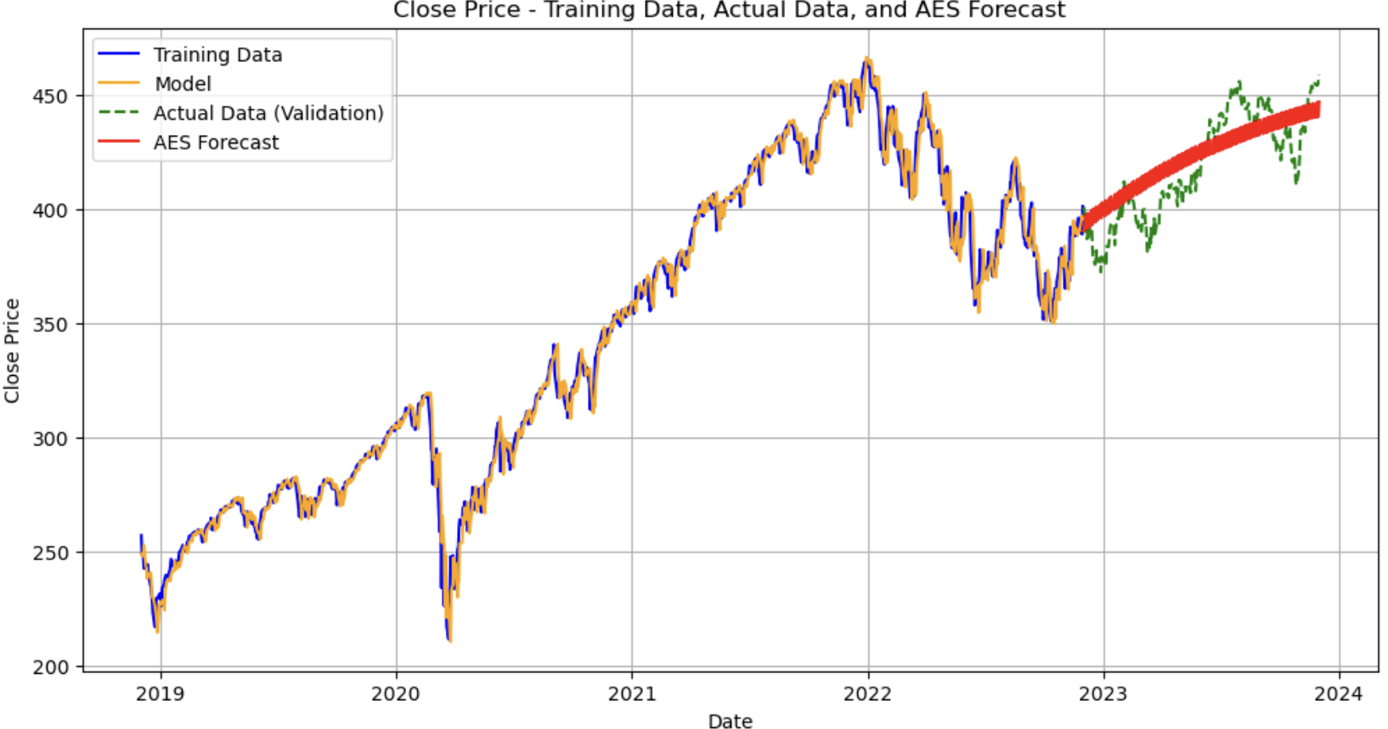
Method: advanced exponential smoothing
Method characteristics:
Percentage of trend
Trend progressively weakens
Look-back 3 days long
3 day long cycle
General / Round estimation
Validation results (eff. 2 Dec 2023)
Forecasted percentage error (MAPE) = 2.83%
Forecasted price error (RMSE) = $13.73
Notes:
Using what is called a smoothing technique, our team was able to deploy a method that focused on the previous three days of price behavior and generalized it to make a prediction of future price movement. Shown here, this method yielded an impressive one-year accuracy of 2.83% error, or $13.73 per share error.

Slide 12
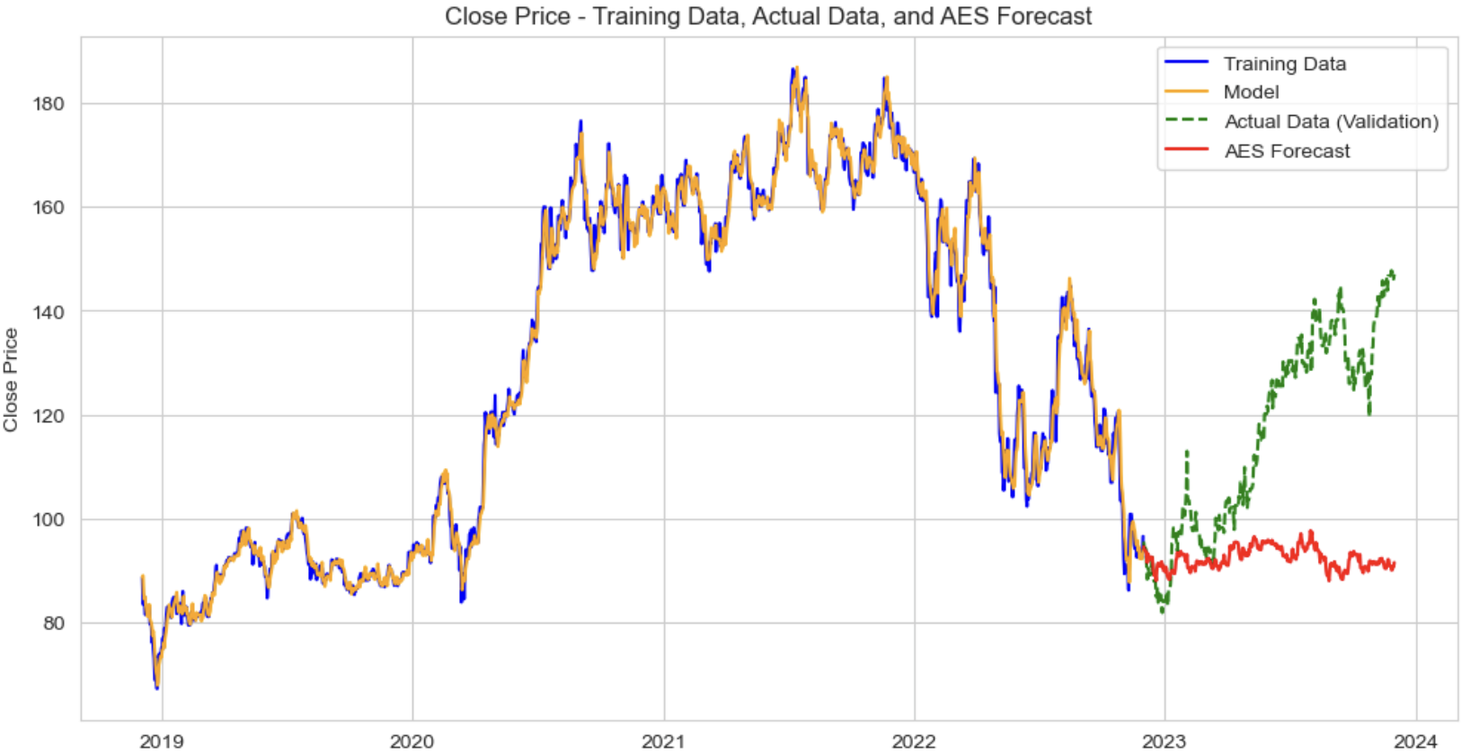
Method: advanced exponential smoothing
Method characteristics:
Percentage of trend
Trend progressively weakens
Look-back 3 days long
3 day long cycle
General / Round estimation
Validation results (eff. 2 Dec 2023)
Forecasted percentage error (MAPE) = 19.29%
Forecasted price error (RMSE) = $30.48
Notes:
However using the same method, but with optimal features selected for Amazon. This method yielded a one-year prediction resulting in 19.29% error, or $30.48 per share error.
This is still within our initial success tolerance, though additional refinement is needed in order to achieve the same power as the S&P method.

Slide 13
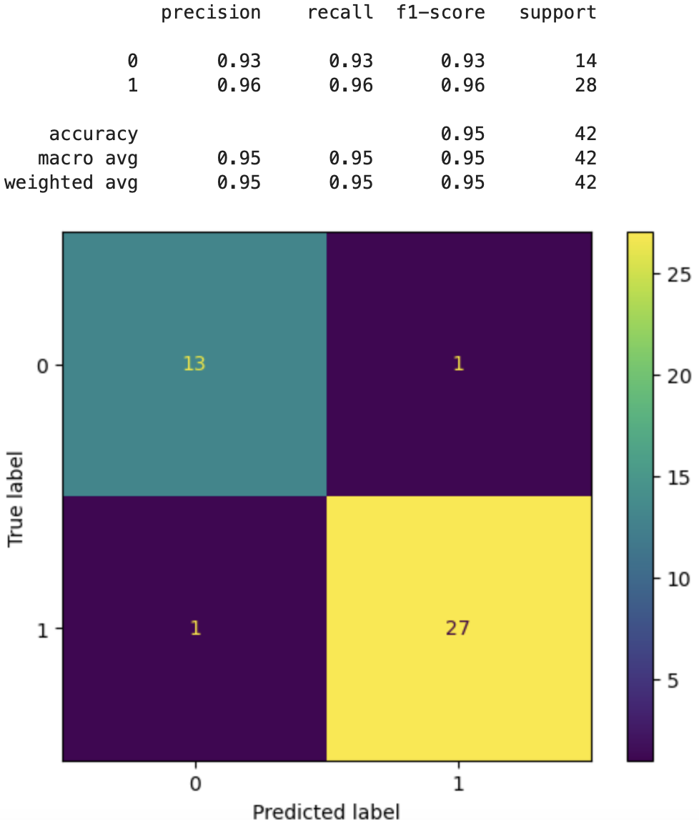
Method: neural network (mlp) Classifier
Hidden Layers (3,2)
Positive
Stock Data
(3 days long)
Negative
Notes:
Our final method used is commonly known as a neural network that learned the price patterns of the S&P 500. Using only two decision layers, the neural network determined with 95% accuracy against validation that the following day would go up or down in price.

Slide 14
Ways forward
Using short observation windows (3 days) is favorable to long term multi-year observation windows for prediction
Index funds, individual stocks, and other investments are not one-size fits all models and methods
Each must be treated and trained independently
Additional external predictors utilizing economic indicators and news sentiment may further increase power
Notes:
So did we meet our initial success criteria?
1. The smoothing models proved to be effective for both within the 20% price prediction error condition.
2. And, we did find additional models and insights that suggest what influences prices to go up or down.
3. Shorter periods of observation have better generalization, resulting in greater predictive power.
In the future, exploring external predictors from economic indicators and news sentiment may further our predictive power to strengthen investor decision-making with the power of data science and time series analysis.

Slide 15
References
Brownlee, J. (2020, April 12). A gentle introduction to exponential smoothing for time series forecasting in Python. Machine Learning
Mastery. https://machinelearningmastery.com/exponential-smoothing-for-time-series-forecasting-in-python/
Chaudhari, S. (2021, February 11). Stationarity in time series analysis explained using Python. Mathematics and Econometrics. https://blog.quantinsti.com/stationarity
ritvikmath. (2020, October 27). Seasonal-trend decomposition using LOESS. Github. https://github.com/ritvikmath/
Shmueli, G. (2016). ARIMA models [Video]. YouTube. https://youtu.be/0xHf-SJ9Z9U?feature=shared
statsmodels. (2023, May 05). statsmodels.tsa.holtwinters.ExponentialSmoothing. statsmodels.
https://www.statsmodels.org/stable/generated/statsmodels.tsa.holtwinters.ExponentialSmoothing.html#
University of San Diego. (n.d.). Lab 1.2: Model selection. University of San Diego.
https://sandiego.instructure.com/courses/847/pages/lab-1-dot-2-model-selection?module_item_id=226903

